Slide 1

Coping with Disaster: Mental Health, Substance Use and Financial Concerns Associated with Online Gambling During COVID-19
Date: May 25, 2022
Time: 1:00 – 2:00 PM EST
Alex Price, PhD
Senior Researcher
Centre for the Advancement of Best Practices
Responsible Gambling Council (RGC)
Notes:
<number>

Slide 2
CAMH Land Acknowledgement
CAMH is situated on lands that have been occupied by First Nations for millennia; lands rich in civilizations with knowledge of medicine, architecture, technology, and extensive trade routes throughout the Americas. In 1860, the site of CAMH appeared in the Colonial Records Office of the British Crown as the council grounds of the Mississaugas of the New Credit, as they were known at the time.
Today, Toronto is covered by the Toronto Purchase, Treaty No. 13 of 1805 with the Mississaugas of the Credit.
Toronto is now home to a vast diversity of First Nations, Inuit and Métis who enrich this city.
CAMH is committed to reconciliation. We will honour the land through programs and places that reflect and respect its heritage. We will embrace the healing traditions of the Ancestors, and weave them into our caring practices. We will create new relationships and partnerships with First Nations, Inuit and Métis – share the land and protect it for future generations.
1
Notes:
<number>

Slide 3
About GGTU
The Gambling, Gaming and Technology Use (GGTU) program is part of the Knowledge Exchange and Training portfolio in CAMH’s Provincial System Support Program. GGTU aims to build a stronger mental health and addictions system in Ontario by supporting addictions and mental health service providers through training and education, digital tools and resources, and knowledge sharing activities.
3
Notes:
<number>

Slide 4
Language
CAMH places equity, diversity and inclusion (EDI) at the centre of our work. We understand that language is constantly evolving as societal and cultural values change. We strive to use language that celebrates the diversity of the communities we serve and remains respectful, inclusive and free of bias. As part of our commitment to EDI, we welcome feedback on our language use and routinely review our content, updating the language as needed.
4

Slide 5
Presenter
Dr. Alex Price is a Senior Researcher with the Centre for the Advancement of Best Practices at RGC. He has spent over 15 years in public health research and practice, including seven years in the field of gambling-related harm. Recently, he has:
Contributed to longitudinal research on people who gamble in Ontario during COVID-19;
Examined regulatory and operational implications of single-event sports betting across Canada;
Investigated health inequities among Chinese, South Asian and Indigenous people who gamble in Ontario; and
Led the province’s first longitudinal gambling prevalence study in nearly 10 years
Dr. Price is also a co-founding member of the Ontario Gambling Research Society and has provided advisory support on Canada’s Lower Risk Gambling Guidelines development.
5

Slide 6

“
On January 10, 1980, I was sent to jail for embezzling a large amount of money. A compulsive gambler, my habit had cost me everything: my family, my finances, and my freedom. When I got out, I knew I needed help staying away from gambling.
When I looked around, I had a hard time finding the services I needed, and I knew I could not the only one. Three years after finding help in the US from Dr. Robert L. Custer and learning everything I could, I formed the Canadian Foundation on Compulsive Gambling. I had an office in my basement and a few dollars in the bank.
-- Tibor Barsony, Founder of the Canadian Foundation on Compulsive Gambling (now RGC), 1983
All in for safer gambling.
Independent, non-profit organization
35+ years of research, prevention, education, and policy guidance in the field of responsible gambling
Work across jurisdictions around the world and with all stakeholders
5
www.responsiblegambling.org
Notes:
<number>

Slide 7

Overview
COVID-19 Gambling Research in ON
Gambling Behaviours
Financial Impacts
Mental Health
Substance Use
Gambling Risk and Harm
Key Population Segments
Implications and Next Steps
5
Notes:
<number>

Slide 8
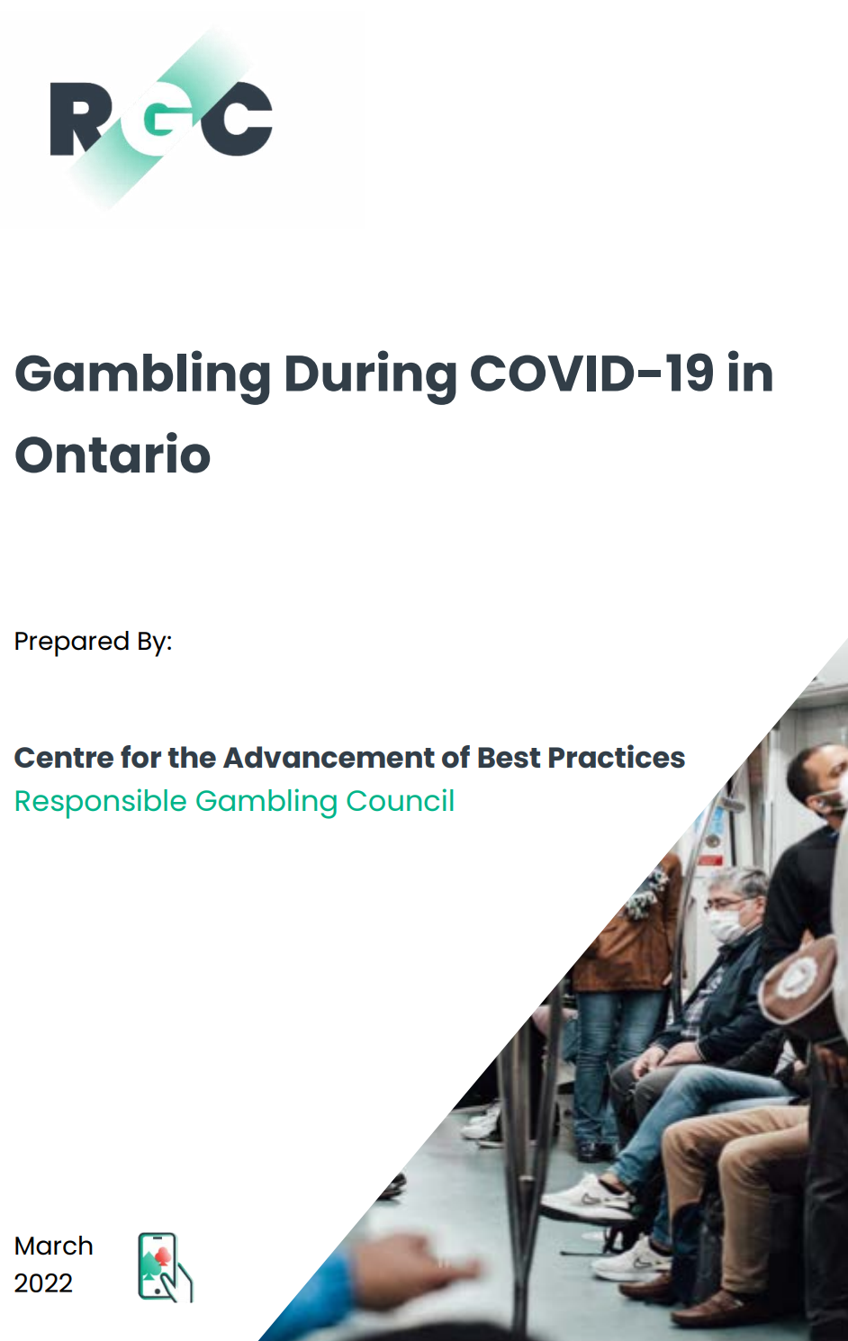
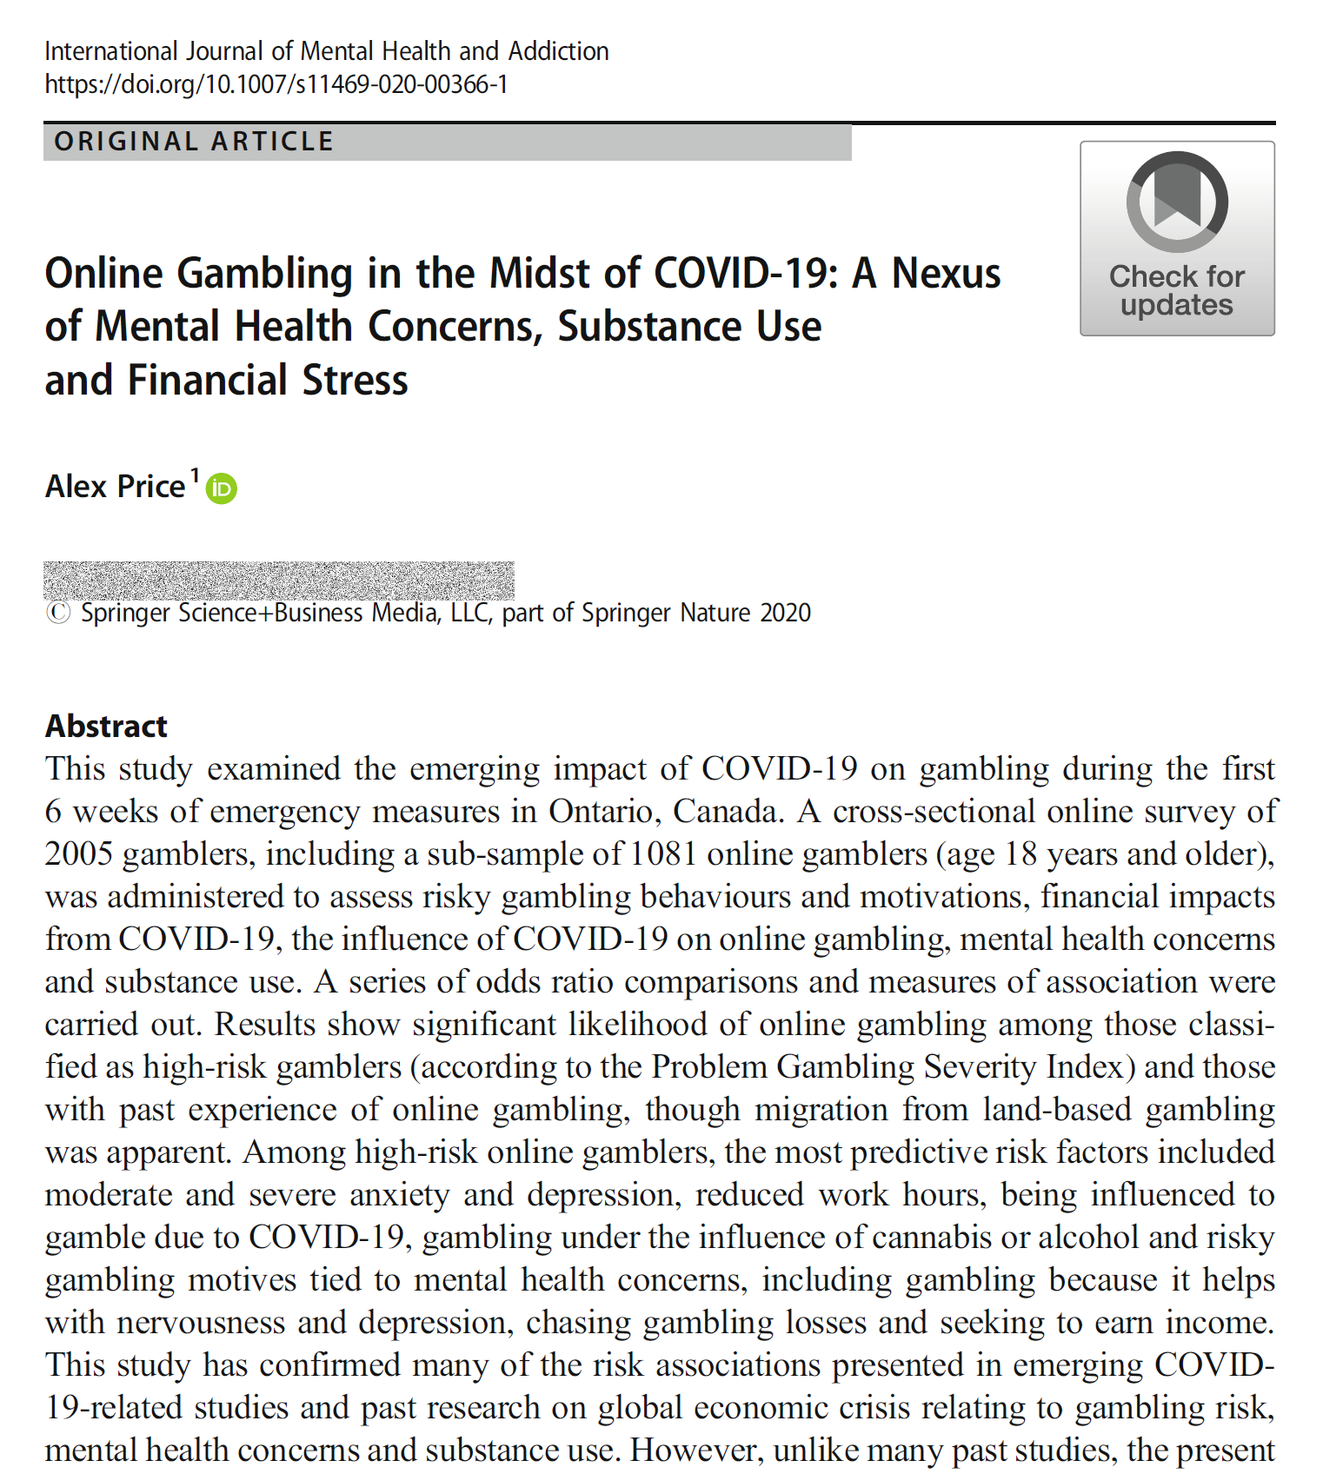
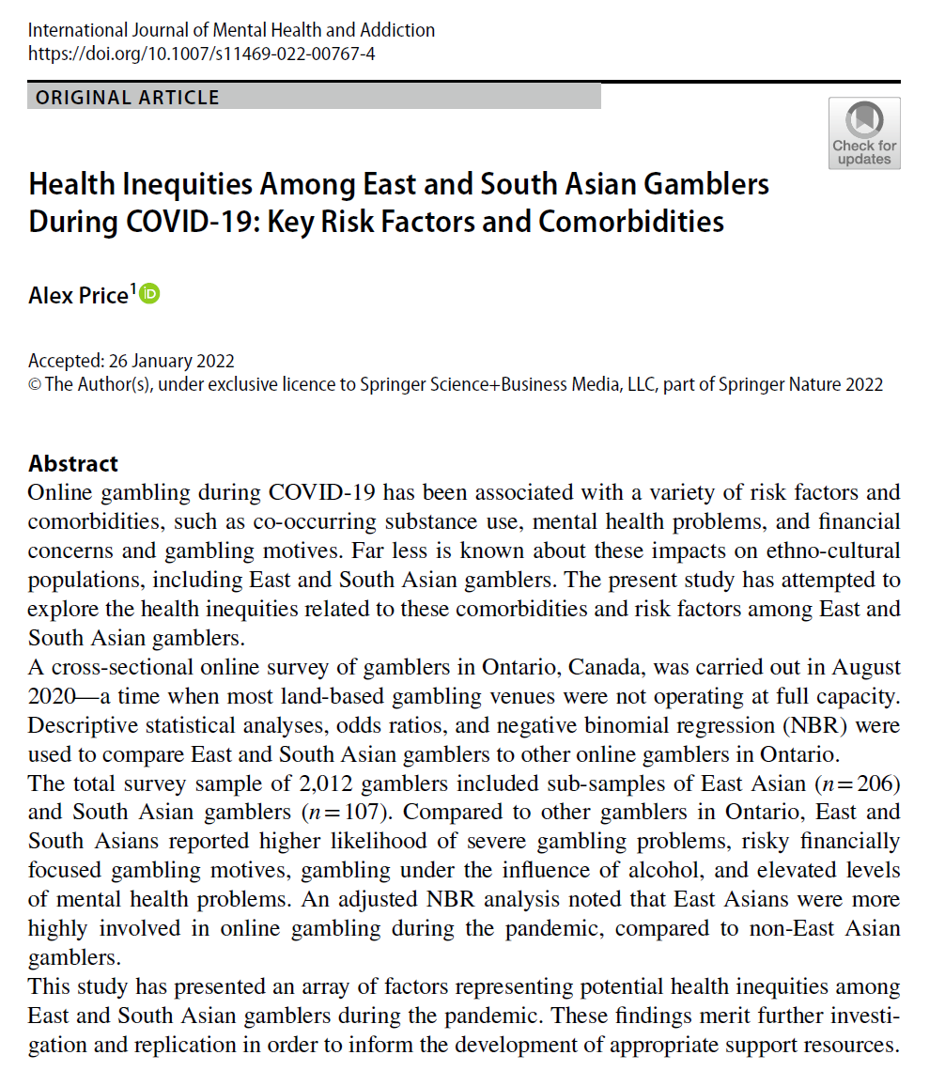
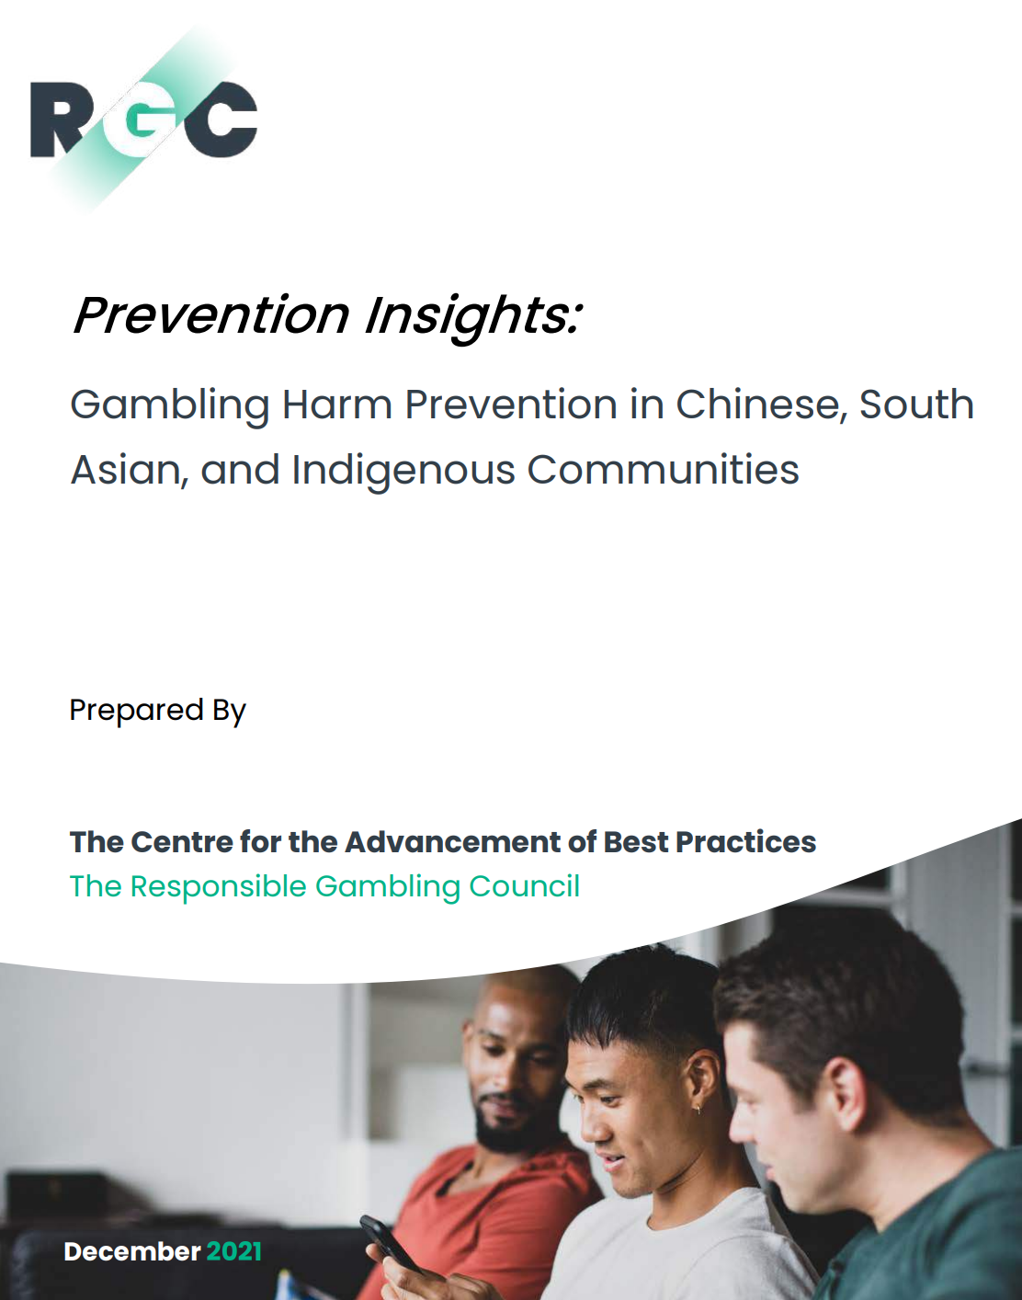
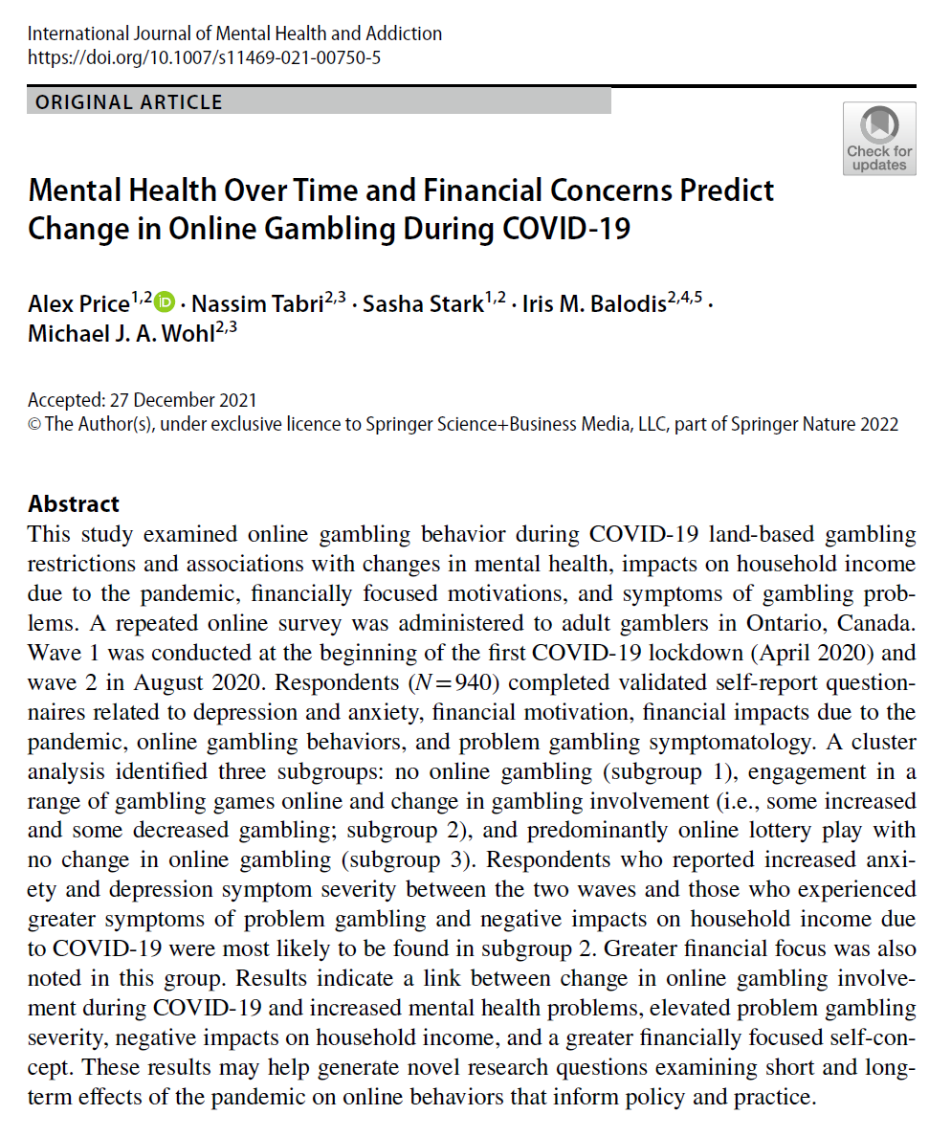
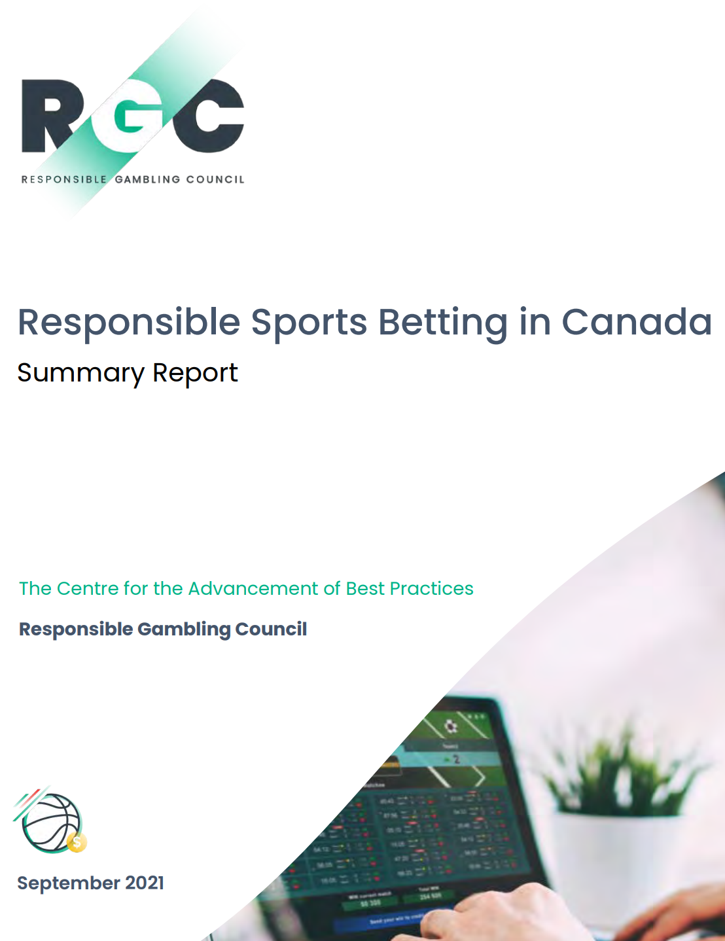
What did we learn from the past 2 years?
Online gambling has shifted in Ontario with evidence of increased and/or substantial engagement
High risk problem gambling appears relatively stable in the province, but at-risk players engaging more online
High risk gamblers are more likely to experience elevated mental health concerns, gamble while intoxicated, and report financial problems tied to the pandemic
There are several distinct populations disproportionately affected by gambling problems in ON
Young adults (18-24, especially males)
Key ethno-cultural groups
And more…
8
Notes:
Wave 1:
HR PG (overall) = 7.6%
HR PG (online) = 12.8 (RR=8x)
<number>

Slide 9
COVID-19 Gambling Research in Ontario
8

Slide 10


Data Developments: RGC and Friends
Sample: 2,015 Online: 1,302 Recontacts: 1,018
March 17, 2020
January 2022
Emergency Declaration
April 2020
Wave 1 of LGS
August 2020
Stage 3 re-opening
November 2020
Toronto and Peel lockdown
January 2021
2nd Emergency Declaration
August 2021
Stage 3 reopening
April 2021
Stay at home order
Omicron closures
Wave 2 of LGS
December 2020
Wave 3 of LGS
July 2021
Sports betting in CAN
September 2021
Ethno-Cultural Study
March 2022
Wave 1 LGP
April 2022
Online gambling expansion in ON
Single-event sports betting legalized
Sample: 2,000 Online: 545 Recontacts: 1,422 Longitudinal: 608
Sample: 2,005 Online: 1,081
Sample: 5,003 (ON=1,155)
Online: 3,933 (ON=928)
Sample: 900
Online: 723
Sample: 5,001
Online: 1,831
8
www.ogrs.ca
Notes:
<number>

Slide 11
Recruitment and Sampling
Online panel (AskingCanadians, 1M+ Canadian sampling pool)
18+ years of age
Ontario residents (3+ months)
past-year gambling experience
Quota-based random selection sampling strategy based on StatsCan census distribution estimates
Age
Male/Female
Geographic region (prevalence study)
11
Notes:
Same panel provider that has populated CAMH’s COVID-19 National Survey Dashboard from May 2020 to January 2022
<number>

Slide 12
Gambling During the Pandemic in Ontario
11

Slide 13
April 2020: In the beginning…
We see the first indications of a shift in online gambling behaviours
11

Slide 14
April to December, 2020: A rapid rise and a dip
Online gambling rose sharply and then dipped
Social distancing measures and isolation influencing online gambling
Online gambling among pre-COVID land-based players: April (43.3%) → August (61.7%) → December (80.2%)
Note: 3-wave repeated measures analysis of variance (ANOVA)
14
Notes:
<number>

Slide 15
April to December 2020: What were people playing?
Online gambling during Year-1 of COVID-19
14
Notes:
TO SUMMARIZE:
Online gambling increased in August then fell in December
New online accounts increased 20% in August
COVID-19 social distancing measures are increasingly influencing the decision to gambling online
PlayOLG represents 2/3 of site preference
Most recorded forms of online gambling have increased
<number>

Slide 16




July 2021: Gambling prior to C-218 ascent
80.3%
Past-year online gambling
ON compared to the rest of Canada:
Significantly higher odds (p<.001) of instant lottery, sports lottery, poker, casino table games, parlay sports betting with bookmaker, sports pools with friends, esports betting, virtual sports betting, horse race betting, novelty and event betting, single-event sports betting
25.4% had signed up for new online account in past 12 months
Odds of betting on single-event sports in ON (14.9%) was over 2x that of other provinces and regions of the country
14
Notes:
80% online gambling was the median for Canada in our survey
<number>

Slide 17
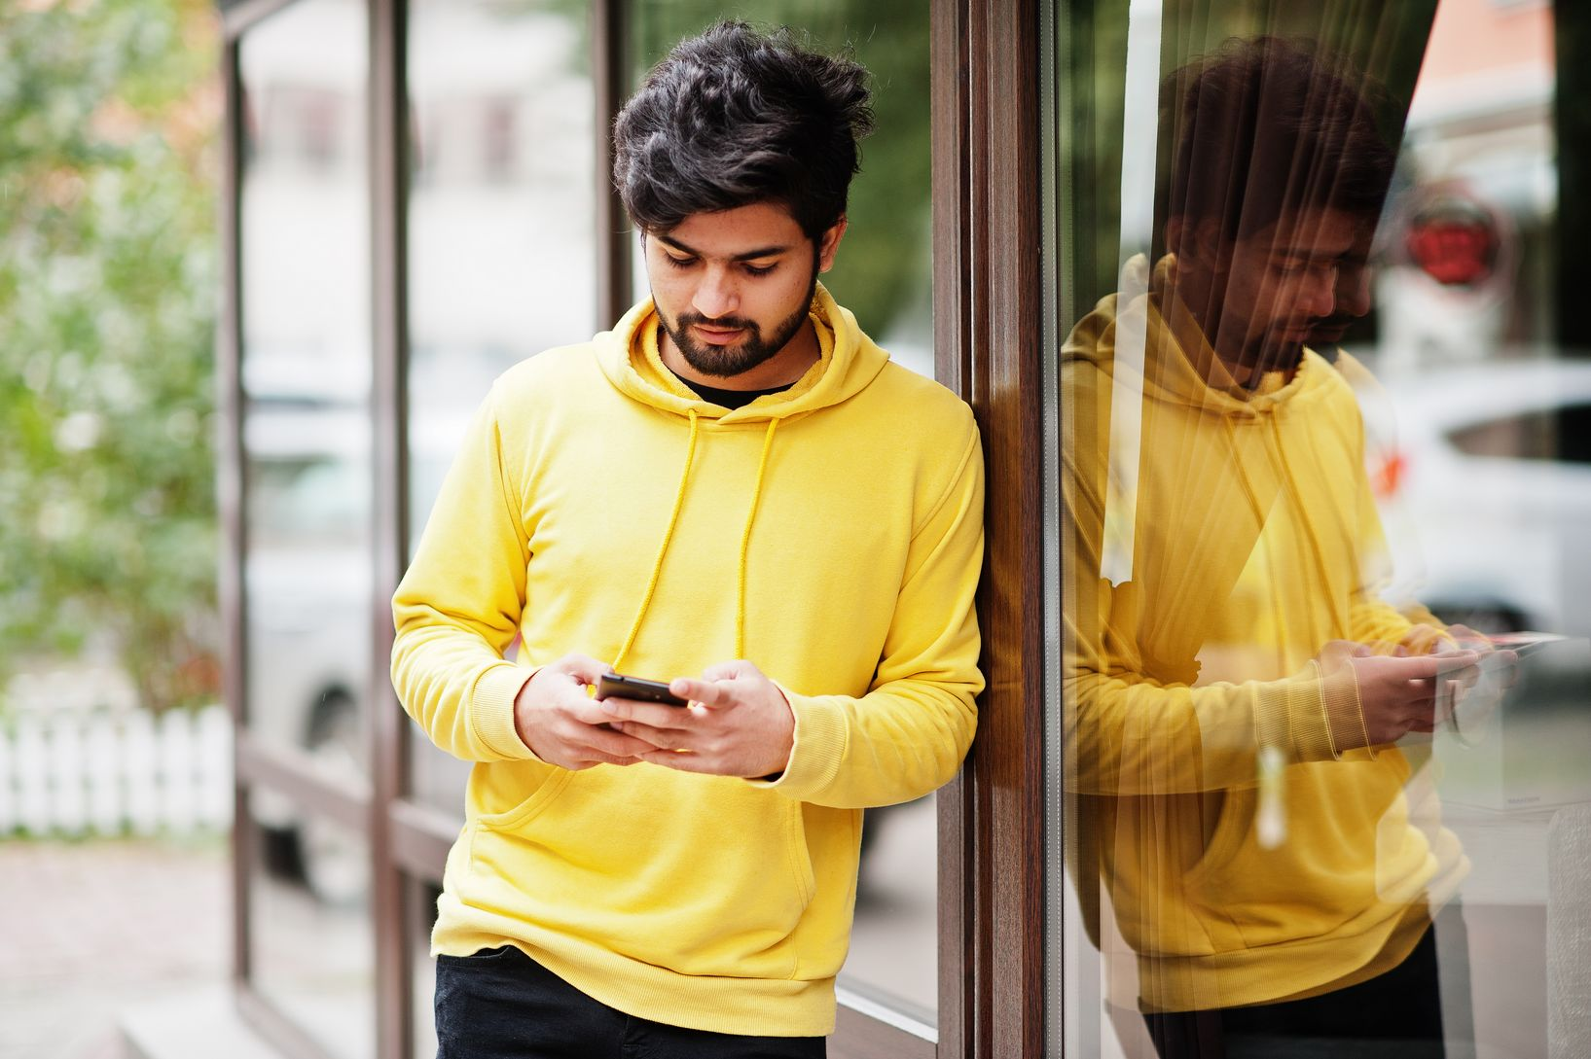
September 2021: Chinese, South Asian and Indigenous Gamblers
80.3%
Past-year online gambling (47.9% before March 2020)
South Asian gamblers most engaged online (88.4%)
20% of South Asian and Indigenous gamblers reported increases in online spending
Online gambling highest among second generation immigrants (86.2%)
Poker and horse race betting were significantly more likely (1.5-2x the odds of non-immigrants and first and 3/4/5/etc. generation immigrants)
14
Notes:
<number>

Slide 18
Financial Impacts and Key Factors
14

Slide 19
April to December 2020
5.5%
Fall in employment across Canada by April 2020
By May 2020, 10.5+ million applications to the Canada Emergency Response Benefit (CERB)
August was a time of gradual re-opening
December was just before Ontario’s 2nd emergency declaration
Financial impacts on gamblers have reflected broader population effects
14
Notes:
<number>

Slide 20
July 2021
35.7%
Household income negatively affected by COVID-19
13.3% reported reduced work hours
6.8% reported lost employment
Financial gambling motives:
To win money (56.7%)
To earn income (32.4%)
Data collected just prior to stage 3 reopening
Reflections cover period of 2nd ED in January and stay-at-home order in April 2021
14

Slide 21
September 2021
Indigenous and South Asian gamblers reported the highest negative impacts on HHI during COVID-19
Indigenous and South Asian gamblers also reported higher extreme endorsement of FFS
14
Notes:
<number>

Slide 22
Mental Health
21

Slide 23
April to December 2020
Anxiety and Depression Symptom Severity: ON LGS and CAMH National COVID-19 Survey
 |  | RGC/OGRS | CAMH
Moderate and Severe Anxiety | April, 2020 | 21.5% | 19.0%
 | August, 2020 | 16.4% | 21.0%
 | December, 2020 | 17.0% | 24.5%
Moderate and Severe Depression | April, 2020 | 21.0% | 20.4%
 | August, 2020 | 18.4% | 18.5%
 | December, 2020 | 21.0% | 21.5%
Note: Findings from 3-wave repeated measures analysis of variance (ANOVA)
21
Notes:
Moderate and severe anxiety
April = 21.5%
August = 16.4%
December = 17%
Moderate, moderately severe and severe depression
April = 21% (minus moderate, 9.2%)
August = 18.4% (minus moderate, 7.3%)
December = 21% (minus moderate, 8.3%)
<number>

Slide 24

July 2021
4.8%
Severe depression (PHQ-9)
3.8% in the rest of Canada
Severe anxiety (GAD-7)
6.8% in the rest of Canada
Significantly higher odds among Ontarian gamblers than those in other provinces and regions (OR=1.35, p<.05)
9.0%
21
Notes:
Depression: moderate, moderately severe AND severe = 33.8% OR 14.2% for mod sev + sev (CAMH dashboard = 18.5%)
Anxiety: moderate AND severe = 20% (CAMH dashboard = 18.5%)
<number>

Slide 25
September 2021
21
Notes:
<number>

Slide 26
Substance Use
21

Slide 27
April 2020
Self-reported substance use increased dramatically following the first Emergency Declaration (March 17, 2020)
Cannabis use increased most substantially, relative to tobacco, alcohol and caffeine
40.7%
48.7%
21
Notes:
<number>

Slide 28
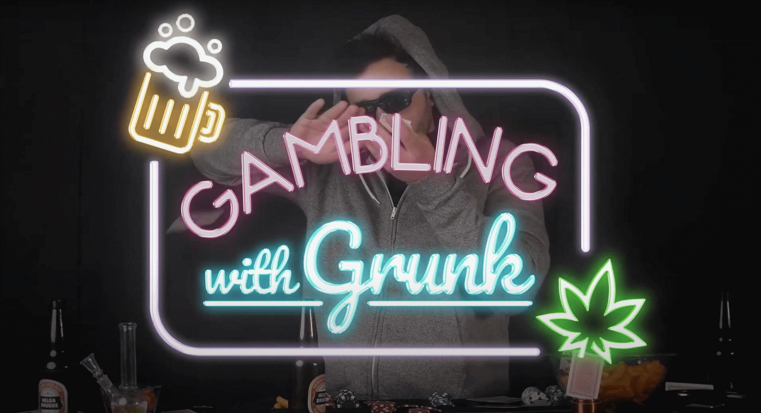
April to December 2020
Note: 3-wave repeated measures analysis of variance (ANOVA)
A YouTube video gambling series titled “Gambling with Grunk” (2021) was created to demonstrate the various consequences of gambling while intoxicated. The series, hosted by a fictional gambling “influencer” named Grunk, attempts to teach Ontarians how to play popular casino games. Produced by the RGC for the AGCO.
27
Notes:
<number>

Slide 29
July and September 2021
July results show consistent rates of intoxicated online gambling for cannabis, but not alcohol
South Asian gamblers reported the highest rates of intoxicated online gambling
29
Notes:
<number>

Slide 30
Gambling Risk and Harm
29

Slide 31
April to December 2020
Note: Findings from 3-wave repeated measures analysis of variance (ANOVA)
29
Notes:
<number>

Slide 32
July 2021
15%
15%
PGSI high risk problem gambling in ON
This estimate was significantly higher than other provinces and regions in the cross-Canada study (n=5,003)
Note:
ON sample was over-represented by 18-24 year (target: ~5%; non-ON: ~12%)
ON sample was under-represented by 65+ (target: ~4%; non-ON: ~6%)
29
Notes:
<number>

Slide 33
September 2021
Gambling Risk Among Chinese, South Asian and Indigenous Gamblers in ON (n=900)
Gambling Harms (SGHS) Among Chinese, South Asian and Indigenous Gamblers in ON (n=900)
29
Notes:
<number>

Slide 34
The Persistent Risk Profile of High-Risk Gamblers
High risk gambling is predicted by severe mental health concerns, negative financial impacts and gambling motives, intoxicated online gambling
Not statistically significant
Note: Figure depicts proportion of PGSI problem gambling and associated key risk factors. Most results are positively correlated (p≤.001; Wave 1 and 3 Lost Employment, p<.05). Wave 1 negative impact on household income not significant.
<number>
Notes:
<number>

Slide 35
Key Populations
<number>

Slide 36
Young Adults (18-24 years)
Financial risk factors and intoxicated online gambling, key areas of concern in the first year of the pandemic
Not statistically significant
Note: Figure depicts proportion of 18-24 year olds and associated key risk factors across waves of data collection. Most results are positively correlated (p<.05).
<number>
Notes:
<number>

Slide 37
Key Ethno-Cultural Groups
July 2021: Cross-Canada Assessment of At-Risk Gambling Populations (n=5,003)
August and December 2020
East Asian Gamblers:
>20% high risk problem gambling
>40% neg. impact on HHI
>40% gambling to earn income
South Asian Gamblers:
>18% high risk problem gambling
2x odds of severe anxiety and depression
39% cannabis intoxicated online gambling
>40% gambling to earn income
<number>
Notes:
<number>

Slide 38
Implications and Next Steps
<number>

Slide 39
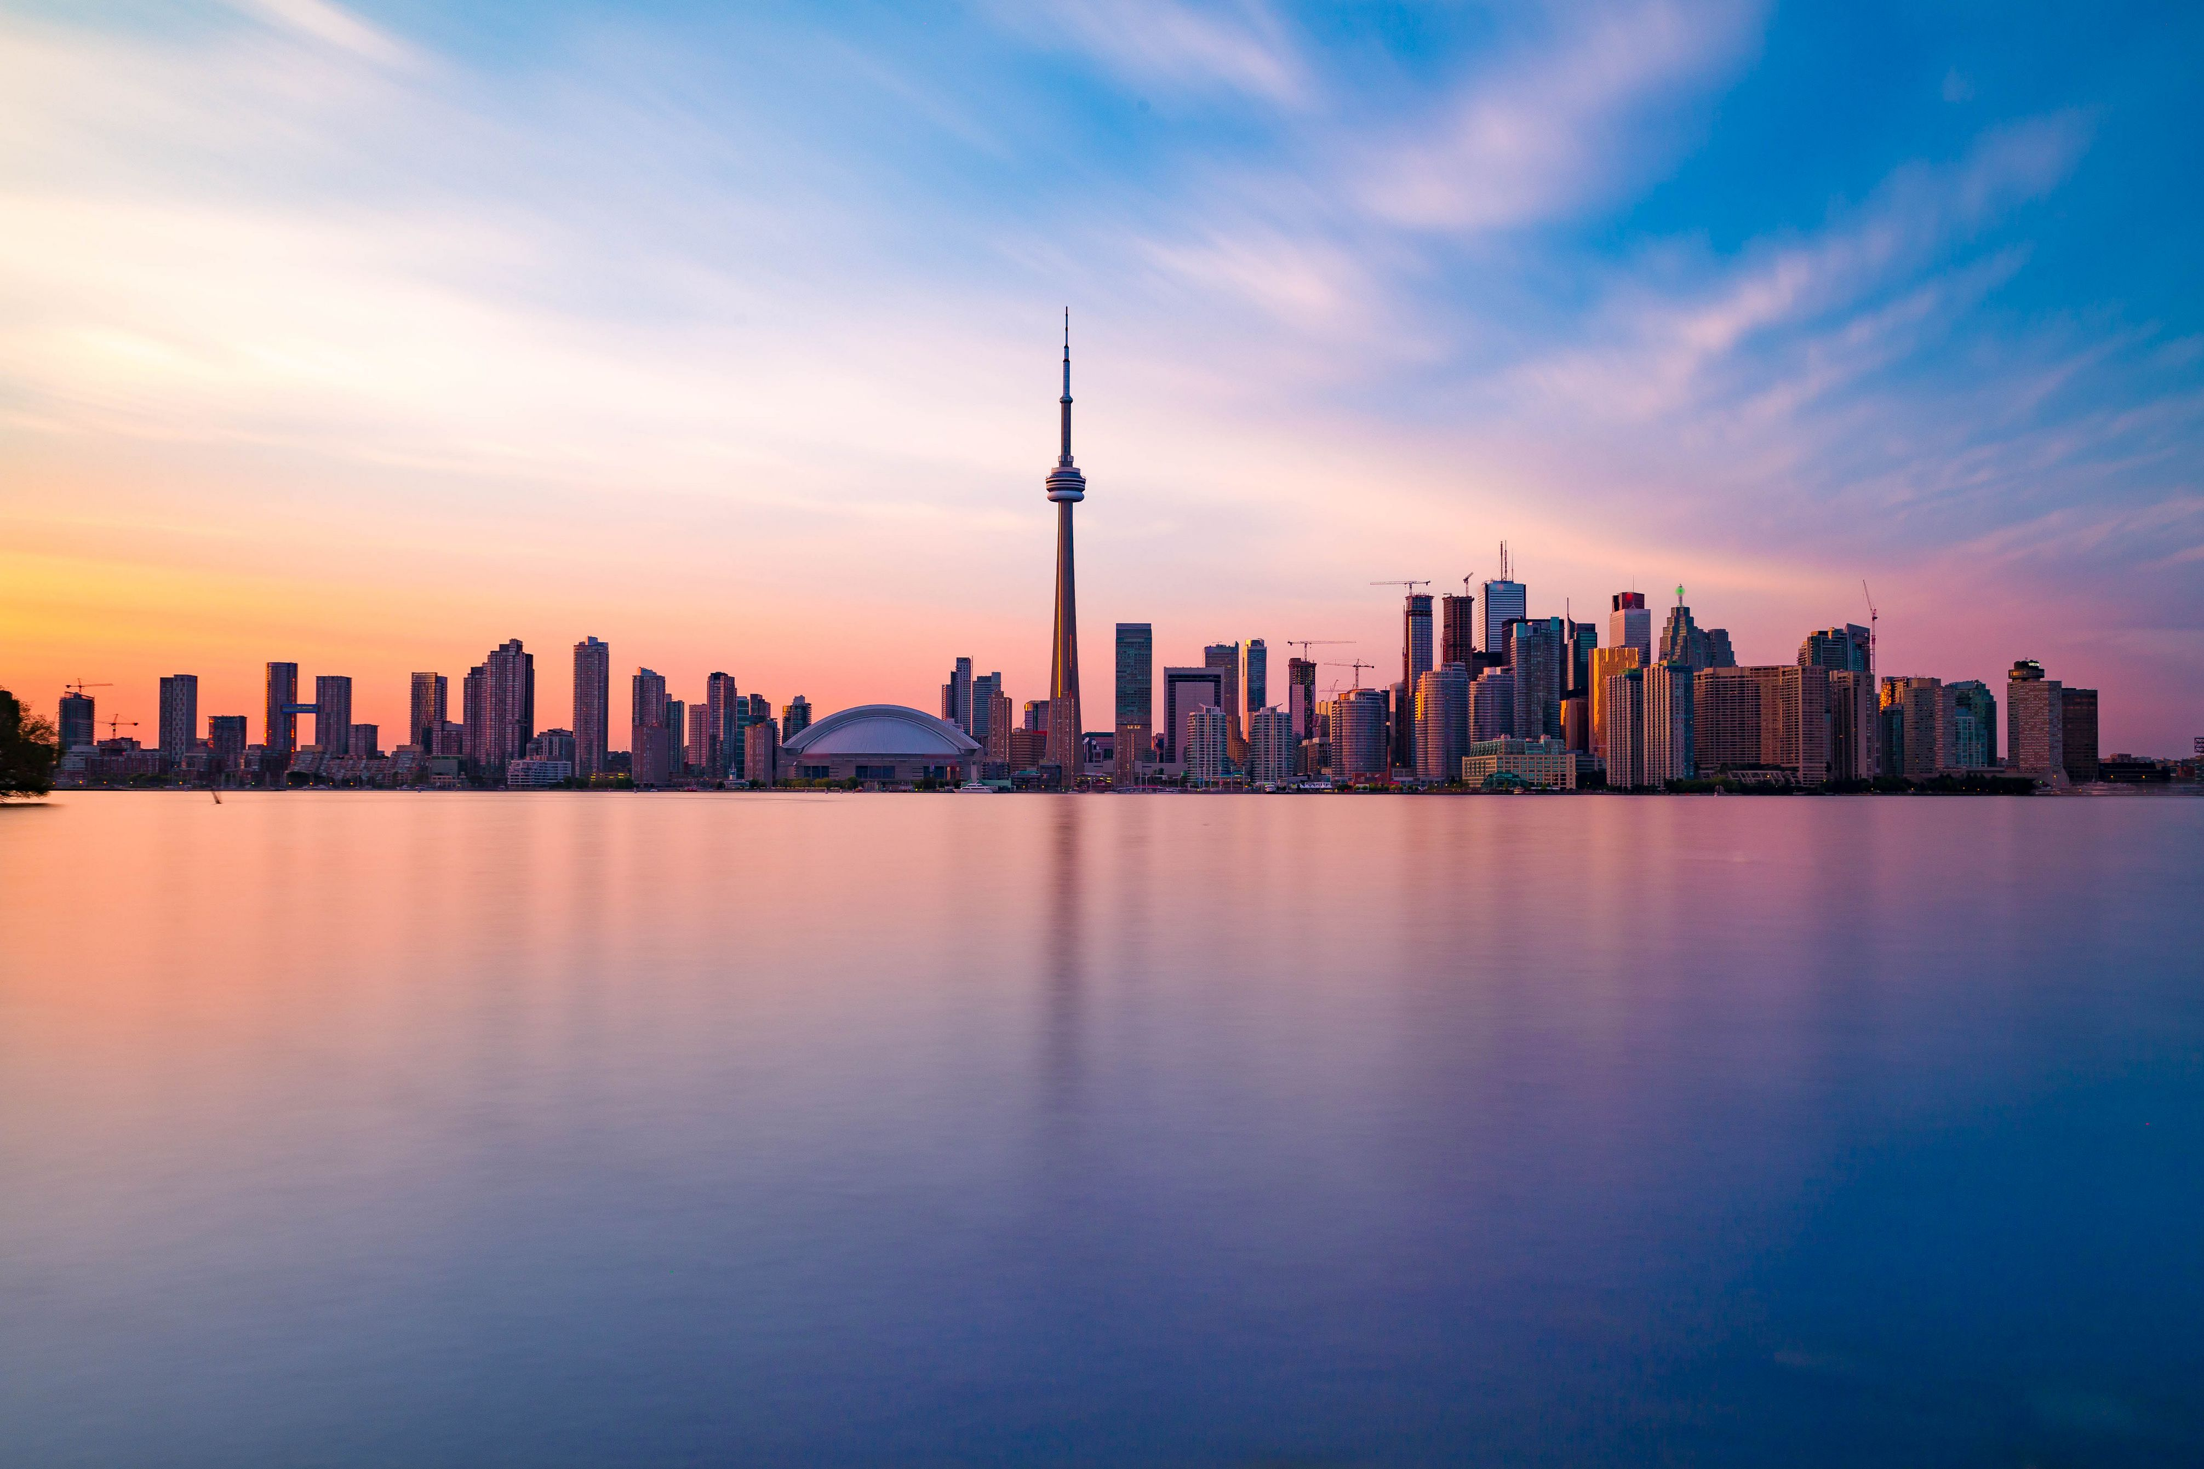
General Implications and Future Steps
Player safeguards: more stringent safeguards in light of COVID-19 impacts; bolstered interactions, staff training, available tools, and markers of harm
Prevention messaging: targeted during COVID-19 restrictions, upon reopening of land-based venues and igaming expansion; tailored to high priority groups
RG resources: expanded online resources for players across the spectrum; consistent and dedicated resources for igaming and sports
Regular monitoring: changes in behaviours and risk during and after the pandemic, with igaming/sports expansion; data required to inform regulatory, prevention, and harm minimization approaches
Continued collaboration: with credit counselling, financial institutions, community groups, and mental health organizations for messaging/programing; with operators for mutual exchange of insights to inform programming/policy
Enhancing clinical practice: …?
<number>
Notes:
<number>

Slide 40
Q&A
<number>

Slide 41
Gambling, Gaming, and Technology Use (GGTU)
Website: https://kmb.camh.ca/ggtu
Join the GGTU Community of Interest!
https://www.eenetconnect.ca/g/gambling-gaming-technology-use
Notes:
<number>

Slide 42
Alex Price, PhD
Senior Researcher
Centre for the Advancement of Best Practices
Responsible Gambling Council
Alexp[at]rgco.org
LinkedIN: www.linkedin.com/in/alex-price-51526937/
www.responsiblegambling.org

